Slide 1
Sales, Profit & Inventory Analysis of Patanjali Retail Distributors
BY:- Shivam Jadhav

Slide 2
Business Problem :-
Patanjali retail distributors face inventory inefficiencies leading to high expiry loss, overstocking, and missed sales opportunities due to stock outs. Management requires a centralized view of sales, profit, stock health, and demand trends across cities and product categories.

Slide 3
Project Objectives :-
Analyze sales and profit performance
Identify top-performing cities and categories
Understand market-wise demand trends
Analyze inventory health (stock & expiry)
Support management decision-making

Slide 4
Dataset Overview :-
Dataset Name: Patanjali Retail Distributor Sales Data
Data Type: Structured retail transaction data
Number of Records: ~50,000+ transactions (approx.)
Number of Columns: 18–20 key variables
Key Attributes:
Transaction ID: Unique identifier for each sale
Date: Transaction date
City / State / Region: Geographic information
Product Name: Patanjali product details
Category: Product category (Food, Personal Care, Ayurvedic, etc.)
MRP / Selling Price / Cost Price: Pricing details
Quantity Sold: Units sold per transaction
Total Sales: Total sales value per transaction
Profit: Profit earned per transaction
Stock Available: Inventory level
Market Type: Urban / Metro / Semi-Urban
Manufacture Date / Expiry Date: Product lifecycle information
Days_To_Expiry: Remaining shelf life in days

Slide 5
Data Cleaning Process :-
Removed null values from critical columns
Handled missing categorical values using mode
Converted date columns to date time format
Removed irrelevant categories
Final clean dataset prepared for analysis

Slide 6
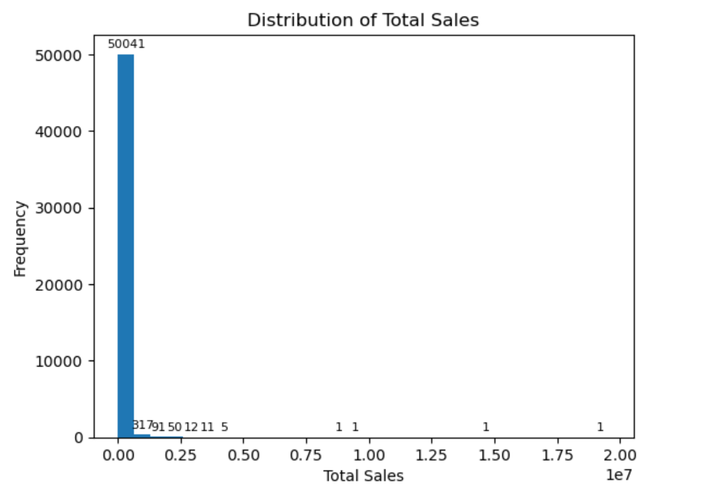
Total Sales Distribution :-
Observation :-
The Total Sales distribution is highly right-skewed, with most transactions concentrated at lower sales values. A large number of transactions generate small to medium sales amounts. Only a few transactions record extremely high sales values, creating visible outliers. These high-value sales significantly increase the overall average sales. The wide spread in sales values indicates variability in order size across customers. This pattern is typical in retail, where bulk purchases contribute disproportionately to total revenue.

Slide 7
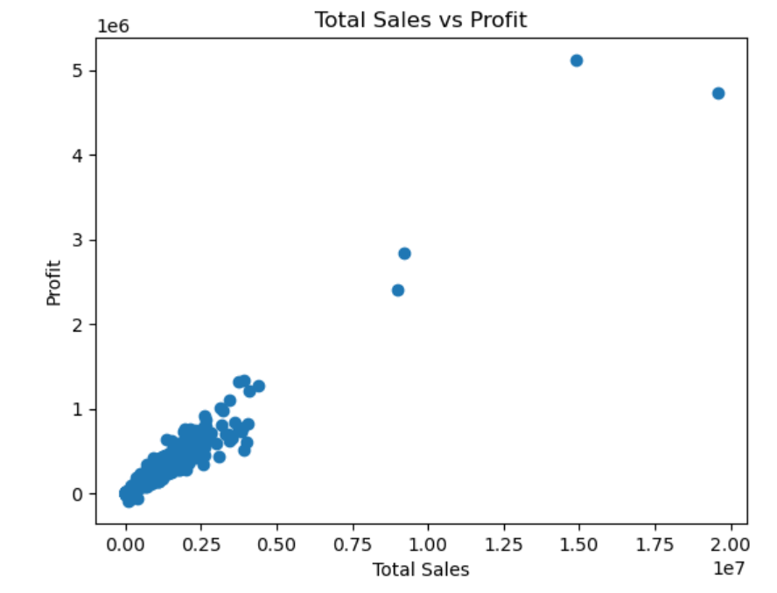
Total Sales vs Profit :-
Observation:-
Total Sales and Profit show a strong positive relationship, where an increase in sales generally results in higher profit. Most transactions fall within low to medium sales ranges but still contribute consistently to profit. A small number of high-value transactions generate a significant portion of total revenue and profit. The presence of these high-value sales increases overall profit variability. This pattern indicates effective pricing and cost management across products. Overall, sales growth directly supports profitability for the business.

Slide 8
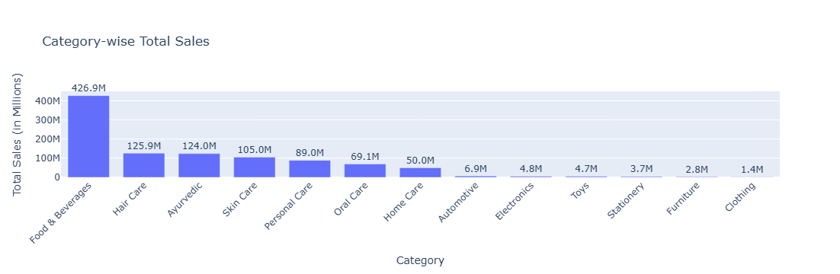
Category-wise Performance:-
Observation:-
Food & Beverages emerges as the top-performing category, contributing the highest share of total sales and acting as the main revenue driver. Hair Care, Ayurvedic, and Skin Care categories also show strong and consistent performance, indicating steady demand. Personal Care and Home Care contribute moderately to overall sales. Categories like Clothing, Furniture, and Stationery record very low sales, suggesting limited demand. Overall, category performance is uneven, with a few categories driving most of the revenue.

Slide 9
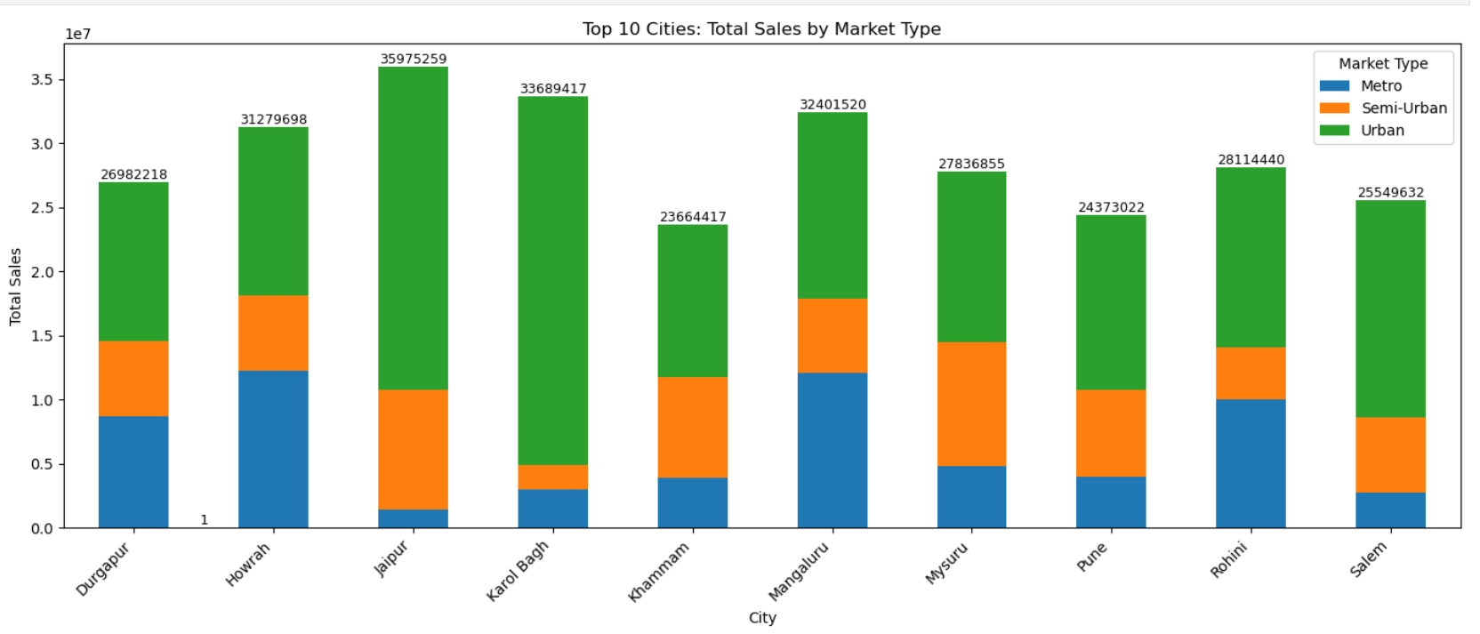
City & Market Type & Total Sales:-
Observation:
Urban markets contribute the highest share of total sales across most cities, making them the primary revenue drivers. Metro markets show strong sales in selected cities, indicating higher purchasing power in those locations. Semi-Urban markets provide consistent but comparatively lower contributions across cities. The mix of market types varies by city, showing that sales performance is location-specific. Overall, city-wise sales are strongly influenced by the dominant market type present in that city.

Slide 10
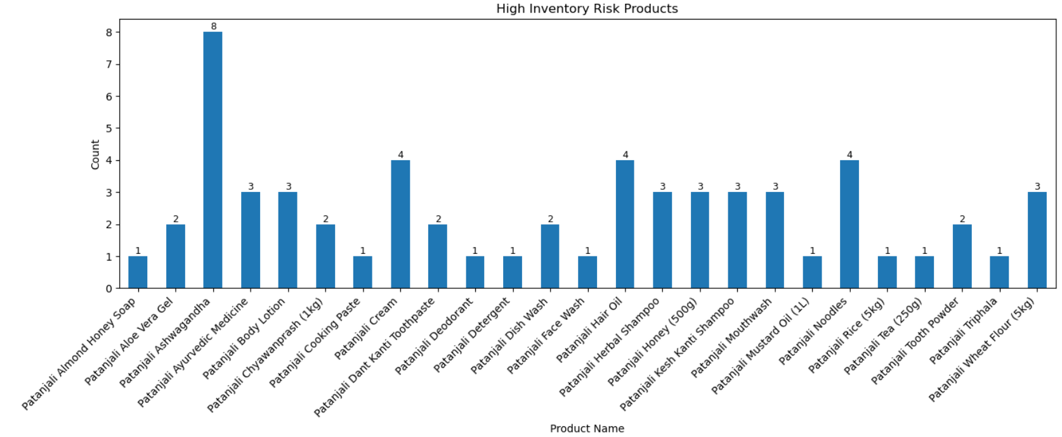
Inventory Risk :-
Observation:
The inventory risk analysis identifies several products with high risk due to low stock availability or nearing expiry dates. These products appear repeatedly, indicating inconsistent demand and stock planning issues. Some items risk expiry losses because they are not moving fast enough. Others face stockout risks, which can lead to missed sales opportunities. The presence of multiple high-risk products suggests gaps in demand forecasting. Inefficient replenishment cycles contribute to inventory imbalance. Overall, inventory health varies significantly across products and needs close monitoring.
.

Slide 11
Key Insights:-
Urban markets are the largest revenue drivers
Sales and profit are strongly correlated
Category performance varies across cities
Inventory planning must be city and market specific
Conclusion:-
This project analyzed Patanjali retail distributor data to understand sales performance, profitability, inventory health, and demand trends. The analysis revealed that Food & Beverages is the primary revenue driver, while sales and profit show a strong positive relationship. Urban markets contribute the highest sales across top cities, highlighting their strategic importance. Inventory risk analysis identified products prone to expiry and stock imbalance, indicating the need for better stock planning. Overall, the insights support data-driven decisions to improve inventory efficiency, reduce losses, and maximize profitability.

Slide 12
Business Recommendations:-
Total Sales Distribution: Since most transactions are low to medium value with a few high-value outliers, the company should focus on high-volume fast-moving products while strategically managing bulk orders to stabilize revenue flow.
Total Sales vs Profit: As sales and profit show a strong positive relationship, management should prioritize increasing sales volume in high-margin products to directly improve overall profitability.
Category-wise Performance: With Food & Beverages and select personal care categories driving most sales, inventory and marketing efforts should be concentrated on top-performing categories while optimizing or reducing low-demand categories.
City × Market Type × Total Sales: Since urban markets dominate sales across most cities, distribution and supply chain strategies should be strengthened in urban areas, with customized plans for metro and semi-urban markets.
Inventory Risk: The presence of high-risk products near expiry or with low stock levels indicates the need for improved demand forecasting and timely stock rotation to minimize losses and prevent stockouts.

